Slide 1
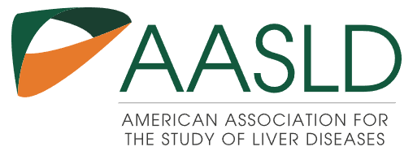

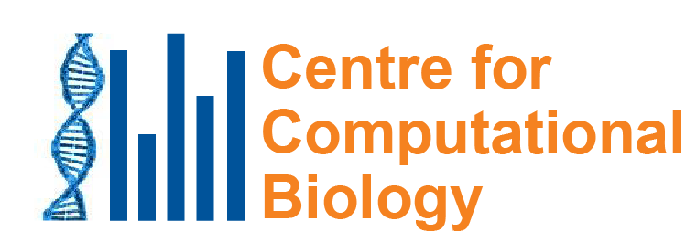
Aristolochic acid in herbal medicine is a common cause of liver cancer
8 September 2022
Hepatotoxicity Special Interest Group Seminar Series
By Zoom
Steven G. Rozen
steverozen@pm.me
Notes:
25 minute talk

Slide 2

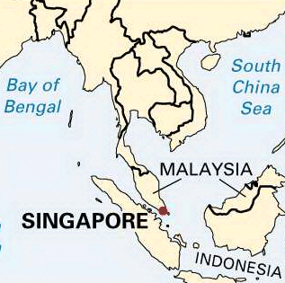
Singapore
Tiny: 50 km (31 mi) east-west
Wealthy and healthy: life expectancy at birth 86.19 (US is 80.43)
70% ethnic Chinese but not part of China
China
http://kids.britannica.com/comptons/art-55105/Singapore
Stats: CIA World Factbook downloaded 2022 03 22

Slide 3
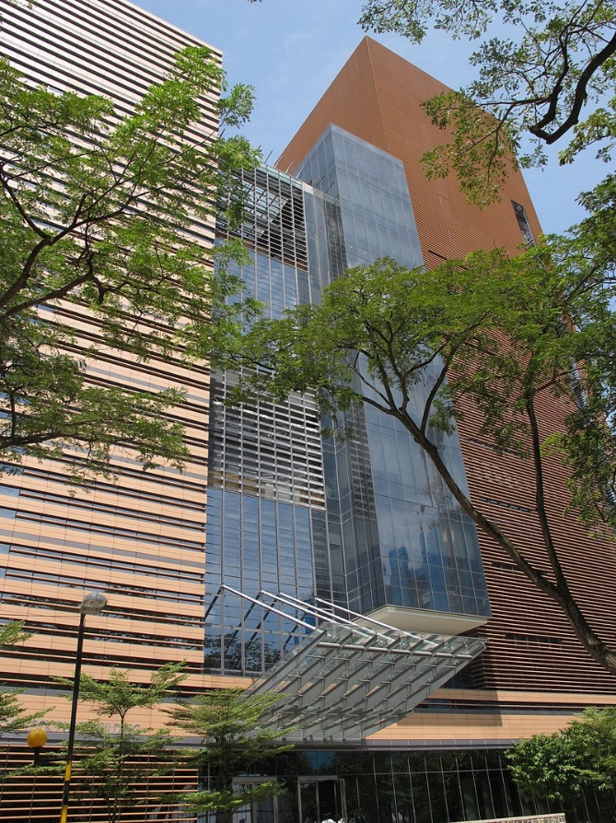
Duke-NUS Medical School
China
Nonprofit partnership
Duke in North Carolina, USA
National University of Singapore (NUS)
SingHealth, largest public healthcare provider, 6 hospitals, 5,500 beds
http://kids.britannica.com/comptons/art-55105/Singapore

Slide 4
Outline
Mutational signatures background
Aristolochic acid and its mutational signature
Aristolochic acid mutagenesis in HCC
Aristolochic acid in non-malignant liver
More questions than answers (regulation)
xxx关木通 slide

Slide 5
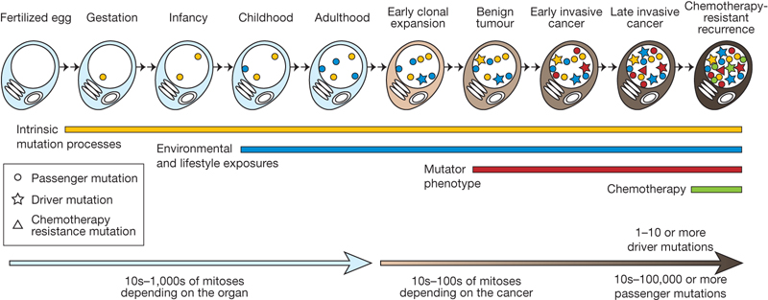
We usually detect somatic mutations by DNA sequencing normal cells and tumour cells
Normal
Normal
…ACGTCCTAGTCAAAATCGAGCC…

Slide 6
We usually detect somatic mutations by DNA sequencing normal cells and tumour cells
and tumor cells
Normal
Tumor
…ACGTCCTAGTCAAAATCGAGCC…
…ACGTCCTAGTCTAAATCGAGCC…

Slide 7
We usually detect somatic mutations by DNA sequencing normal cells and tumour cells
and tumor cells
We look for the variants found only in the tumor
Normal
Tumor
…ACGTCCTAGTCAAAATCGAGCC…
…ACGTCCTAGTCTAAATCGAGCC…
Somatic mutation from A > T
CAA > CTA
Useful information in neighboring bases

Slide 8
We look at all mutations (most are not causing the cancer; they are innocent bystanders)

Slide 9
We look at all mutations (most are not causing the cancer; they are innocent bystanders)
We want to know: what processes mutated the DNA?
?

Slide 10
We look at all mutations (most are not causing the cancer; they are innocent bystanders)
We want to know: what processes mutated the DNA?
Later, we can think about how some of the mutations promote cancer
?

Slide 11
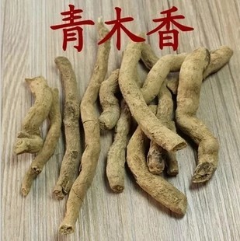
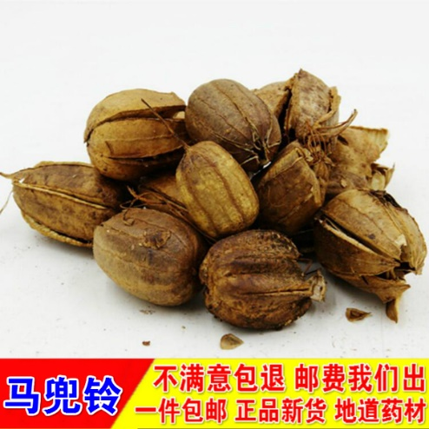
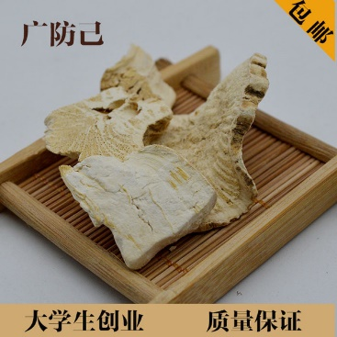
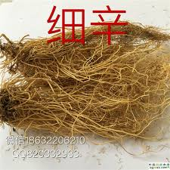
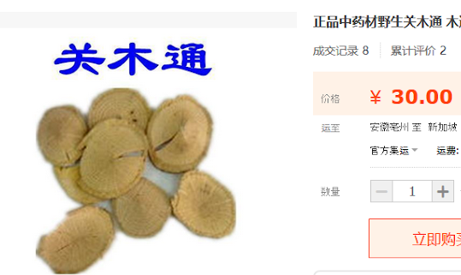
Cancer epidemiology and prevention: aristolochic acid (AA) AA occurs naturally in plants widely used as herbal medicine

Slide 12
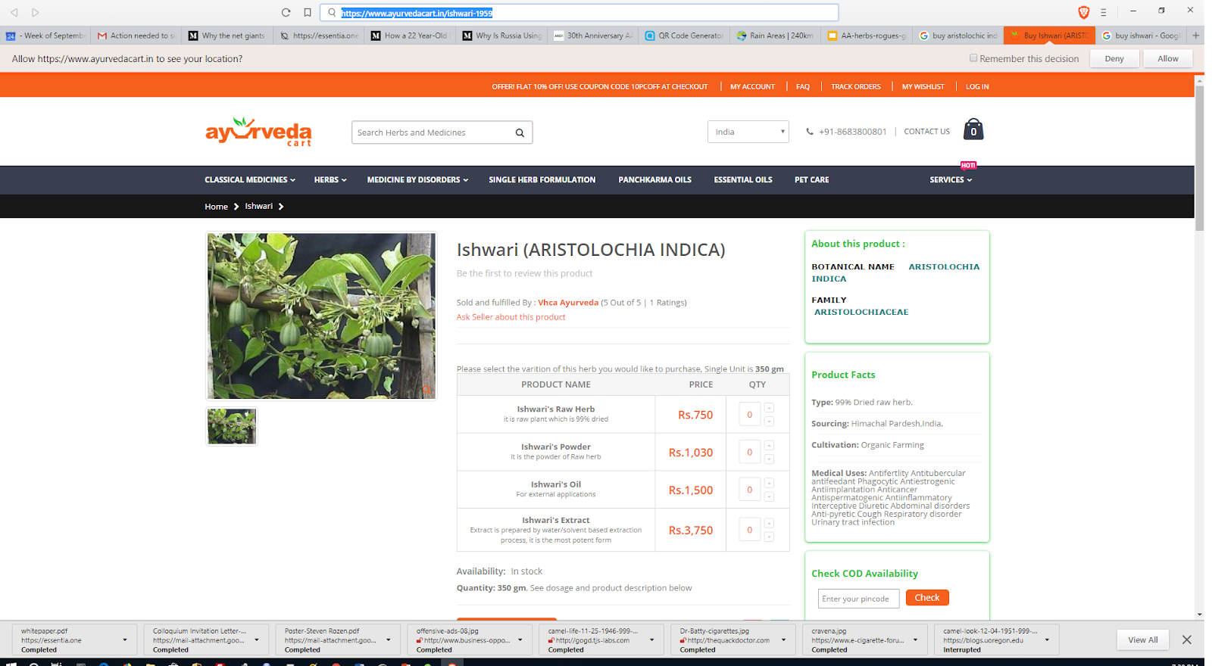
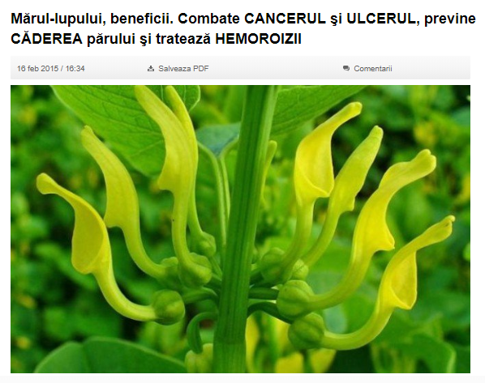
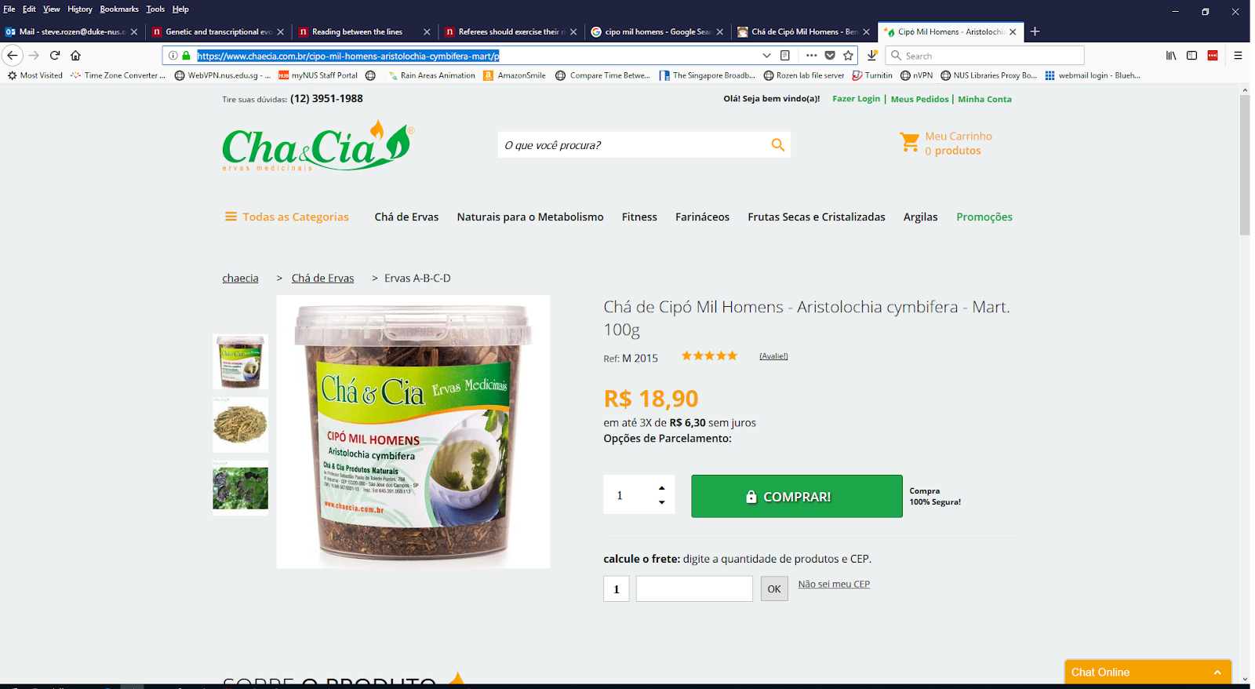
Not just Chinese herbal medicine
Romania
India
Aristolochia indica
Brazil
Aristolochia clematitis
Combats cancer, ulcers, prevents hair loss and hemorrhoids
Aristolochia cymbifera

Slide 13
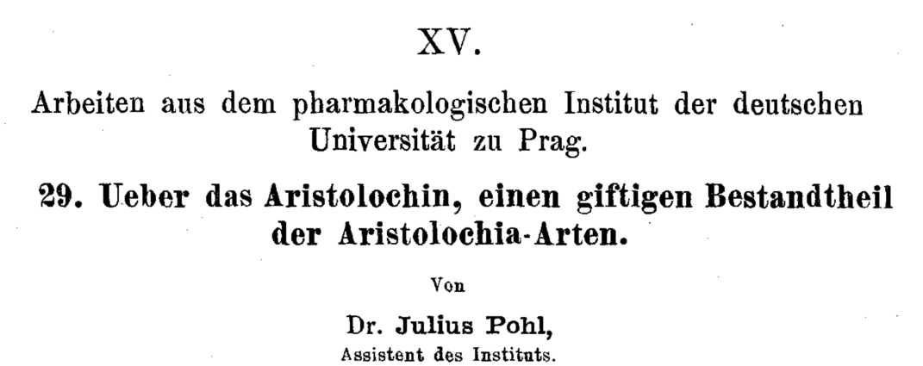
AA: well-known nephrotoxin
1891

Slide 14
1990s: AA emerged as a human health problem
~100 young women developed end stage kidney disease
Single weight-loss clinic in Europe
汉(漢)防己, hàn fáng jǐ replaced by 广(廣)防己, guǎng fáng jǐ
Notes:
Dose: (Cosyns 2003; Nortier et al. 2000)
Adducts: Nortier et al., 2000

Slide 15
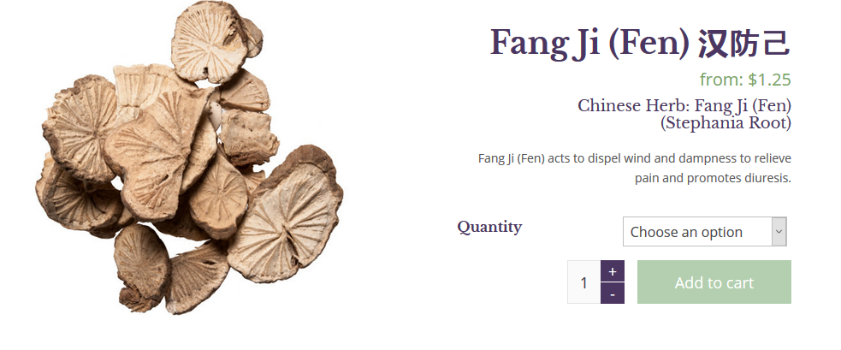
漢防己, 汉防己, hàn fáng jǐ (genus Stephania – no AA)

Slide 16
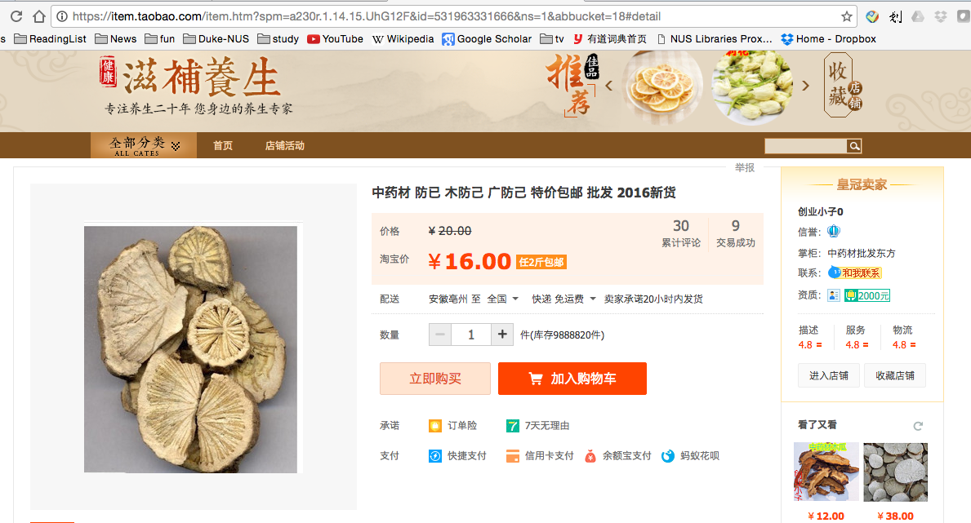
廣防己, 广防己, guǎng fáng jǐ (genus Aristolochia – has AA)
Notes:
Total of 0.5 g over average of 13 months
AA adducts

Slide 17
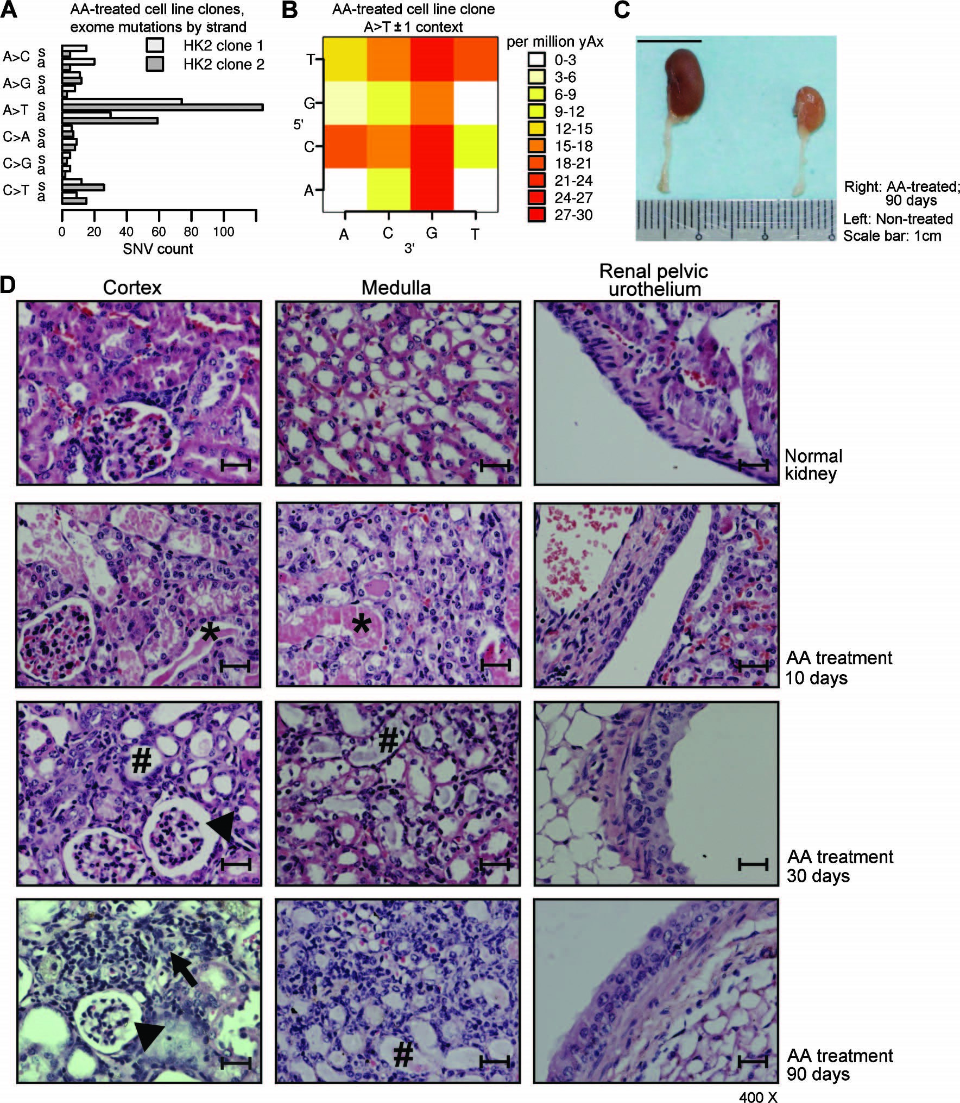
Details of kidney damage from AA
Important: Leads to cancer
Many patients with AA kidney failure developed urothelial cancer
(Nortier et al., 2000, NEJM)
Untreated
Upper tract (near kidney)
Normally rare
90 days after AA
exposure
Inflammatory infiltration
Urothelial dysplasia
Glomerulus: ischemic shrinkage
Tubule with naked basement membrane (necrotic epithelium)
Poon, 2013, doi:10.1126/scitranslmed.3006086
400X, scale bar: 25 μm
Notes:
mouse kidney (hematoxylin and eosin staining, ×400; scale bars, 25 um)
day 10,: accumulation of proteinaceous fluid within the tubules of the AA-treated kidney (*)
days 30 and 90: tubular epithelial cells were necrotic and had collapsed, leaving the tubular basement membrane naked (#). There were few signs of regeneration.
The glomeruli demonstrated ischemic shrinkage (arrowhead).
Dat 90 local inflammatory infiltration (arrow) in the interstitium,
urothelial dysplasia had developed
(50 mg/kg) for 3 days
Cosyns: intraperitoneal 0.1 mg AA/kg/day 5/7 days during 17 (N 5 5) and 21 (N 5 6)
Estimated dose in Belgium? In he *powder* it was up to 2.9 mg / g – see Identification of aristolochic acids in Chinese herbs. Lancet 1994;343:174 ??? Cannot find
From Dickman review: “The maximal daily dose of AA ingested by the cluster of Belgian women is estimated to be 0.025 mg kg1 body weight daily for an average of 13 months (Cosyns 2003; Nortier et al. 2000), “

Slide 18
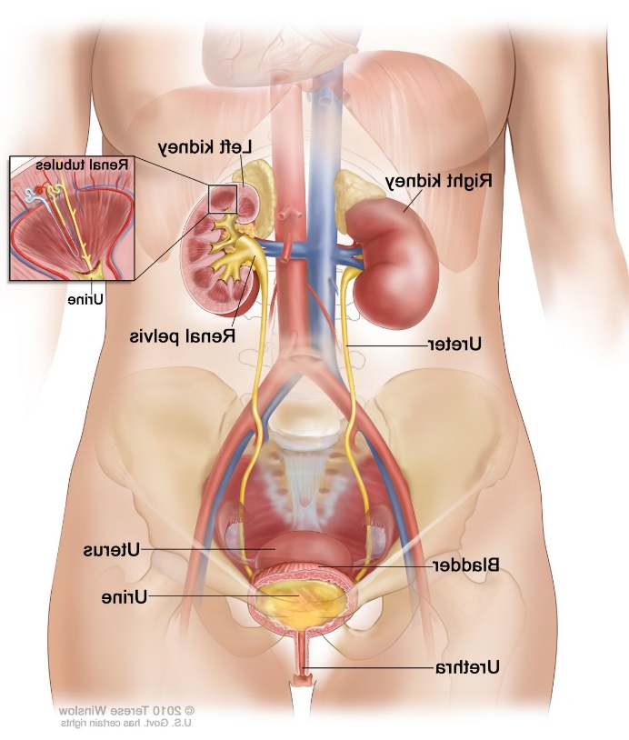
AA identified as a carcinogen:
Many of the AA-kidney-failure victims developed upper tract urothelial cancer
(Nortier et al., 2000, NEJM)

Slide 19
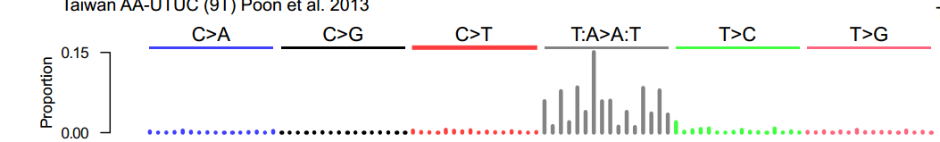
Mutational signature in an AA-exposed upper tract urothelial carcinoma
More
mutations
Each bar represents the total number of single nucleotide mutations in a particular context
Highest bar represents the number of CAG to CTG mutations across the entire genome
The higher the bar, the more CAG to CTG mutations
Poon et al. and Hoang et al. , Science Translational Medicine, 2013

Slide 20
Mutational signature in an AA-exposed upper tract urothelial carcinoma
More
mutations
AAG > ATG mutations
Not as many
Highest bar represents the number of CAG to CTG mutations across the entire genome
The higher the bar, the more CAG to CTG mutations
Mutations from C to A, C to G, C to T
Almost none
Poon et al. and Hoang et al. , Science Translational Medicine, 2013

Slide 21
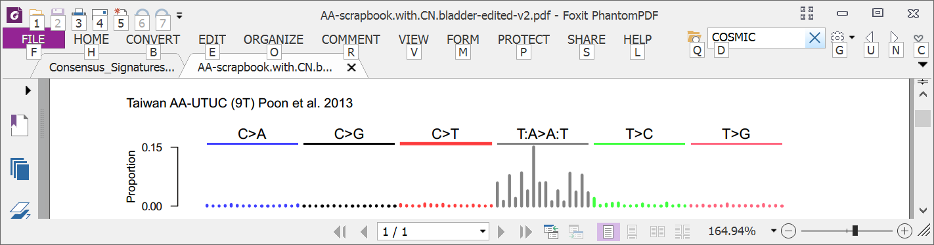
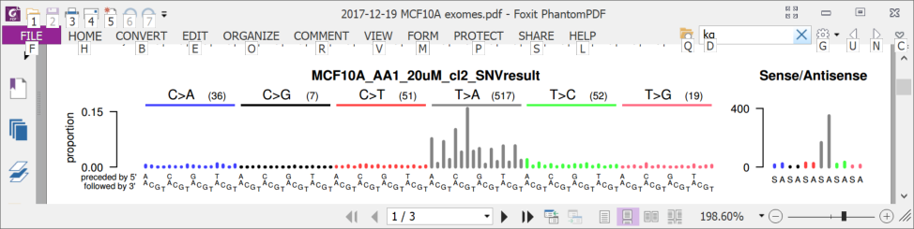
2013: AA mutational signature in upper tract urothelial cancer and cell lines
Upper tract urothelial
AA exposed cell line
Poon et al. and Hoang et al. , Science Translational Medicine, 2013

Slide 22
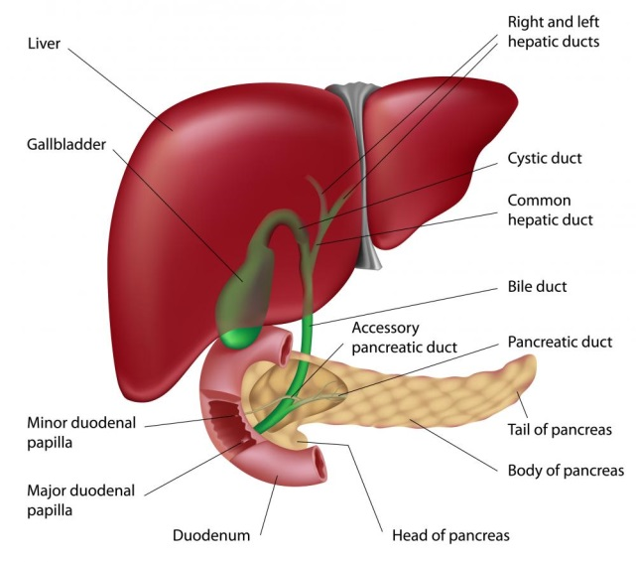
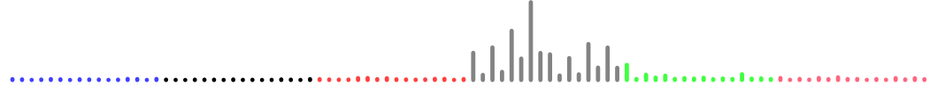
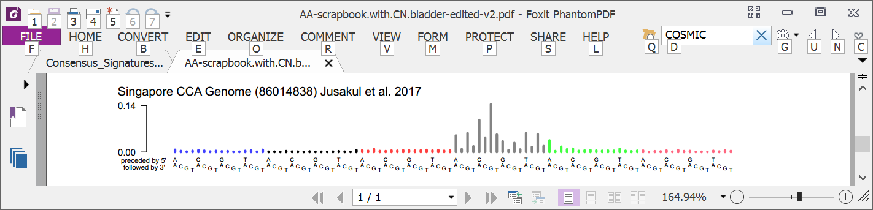
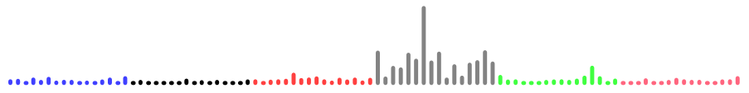
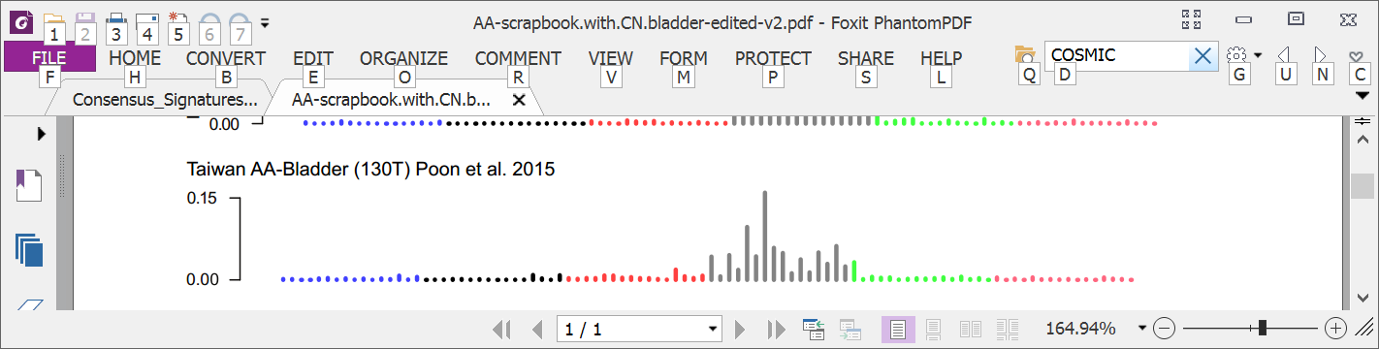
2016: AA mutational signature in multiple tumor types
Liver
Bile duct
Kidney
Upper tract urothelial
Bladder
Poon et al., 2013 and subsequent data (liver - hepatocellular carcinoma [HCC])
Zou et al., 2015, Jusakul et al., 2017 (bile duct carcinoma)
Scelo et al., 2014, Jelakovic et al., 2014 (kidney/renal cell carcinoma)
Poon et al., 2013, Hoang et al., 2013, many others (upper tract urothelial carcinoma)
Poon et al., 2015, others (bladder urothelial carcinoma)

Slide 23

2016: Taiwan a known hotspot for AA kidney failure and AA upper-tract urothelial cancer A good place to investigate AA in liver cancer
Chen, …., Grollman, PNAS, 2012
Map created by Freepik

Slide 24
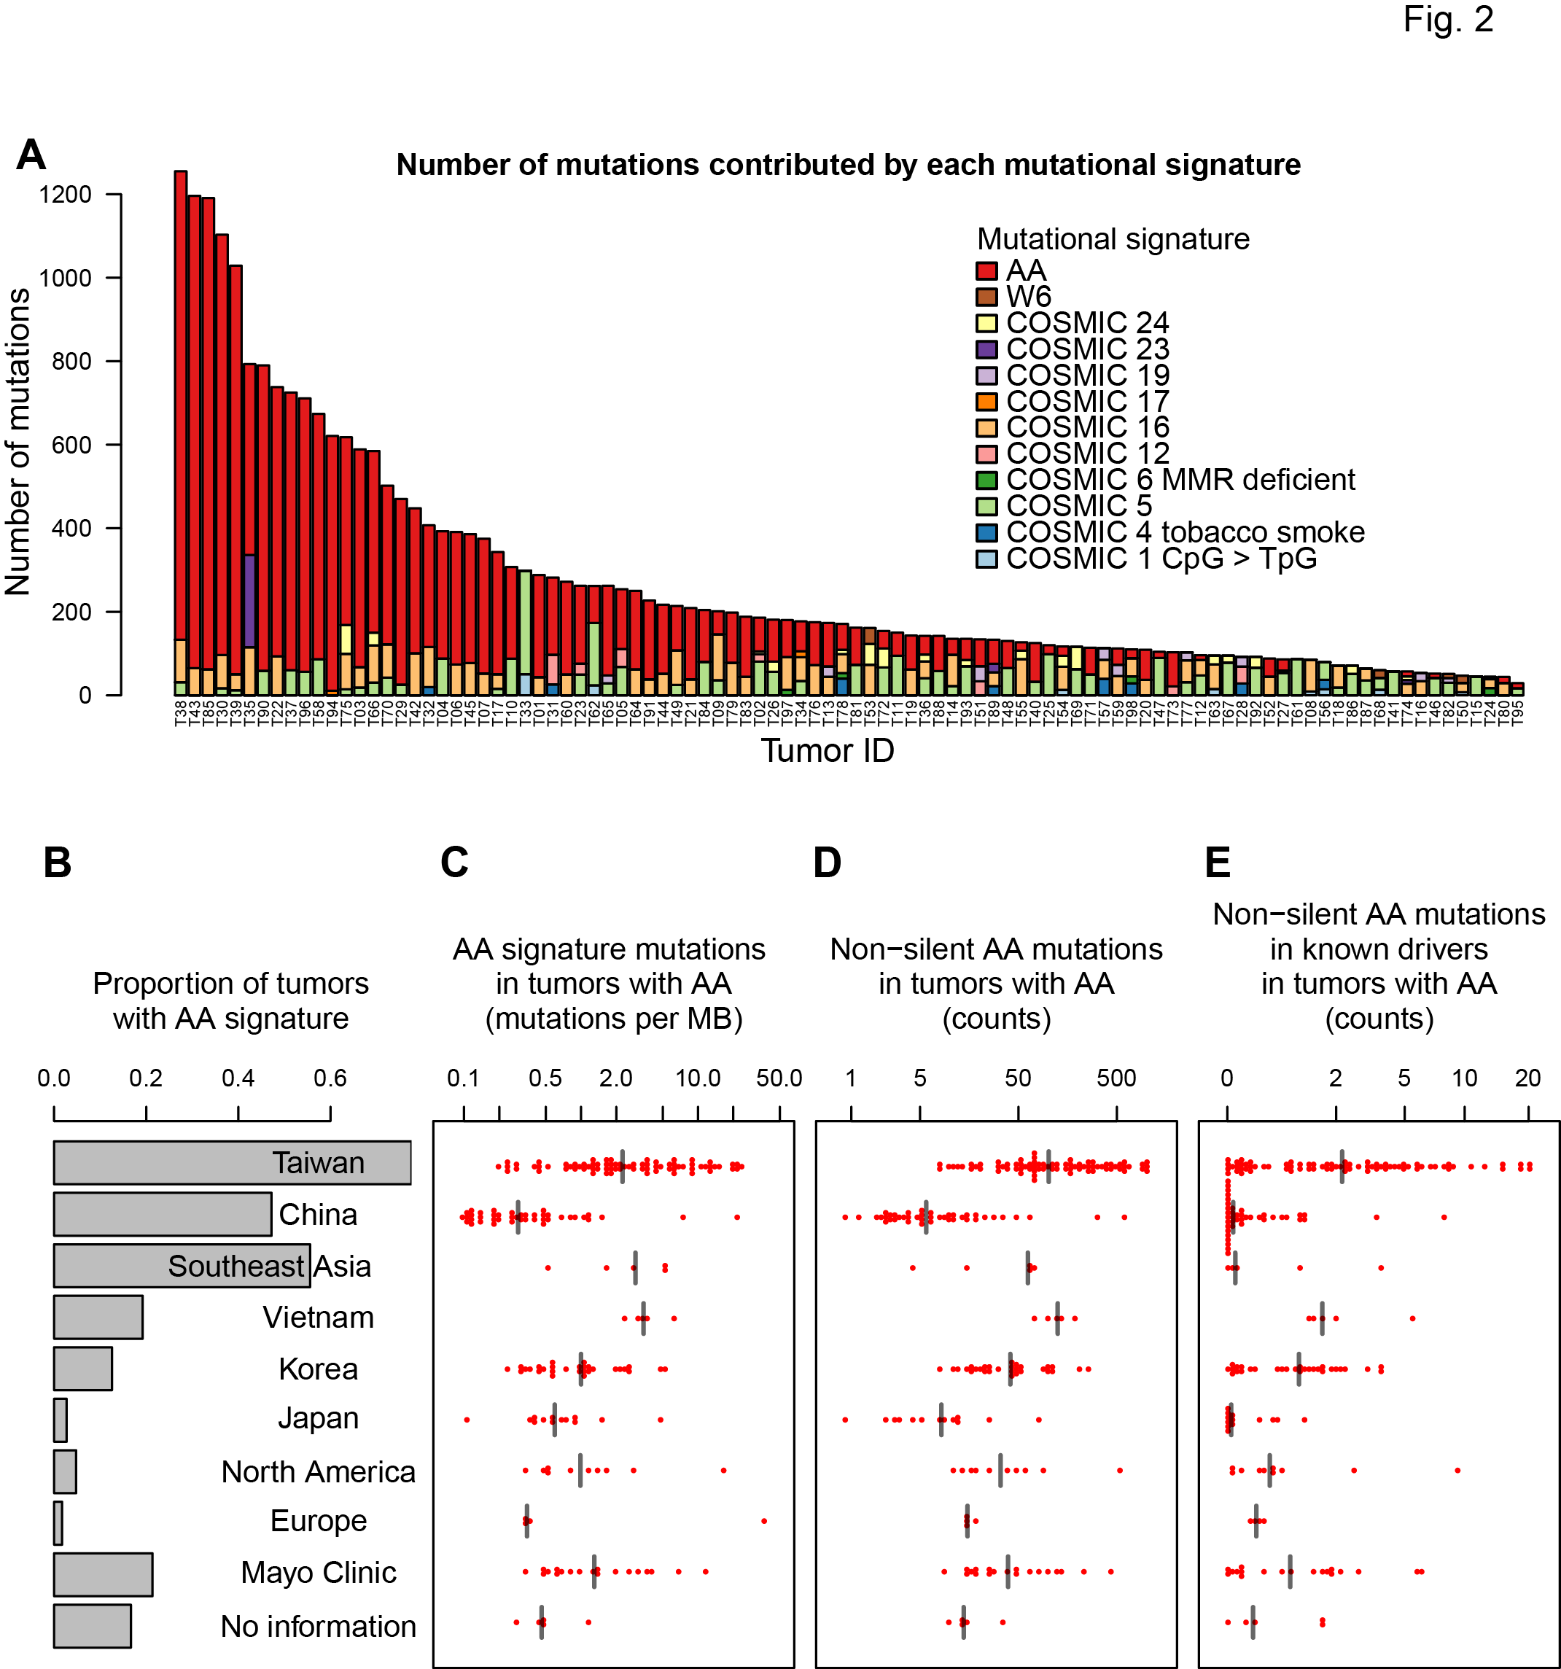
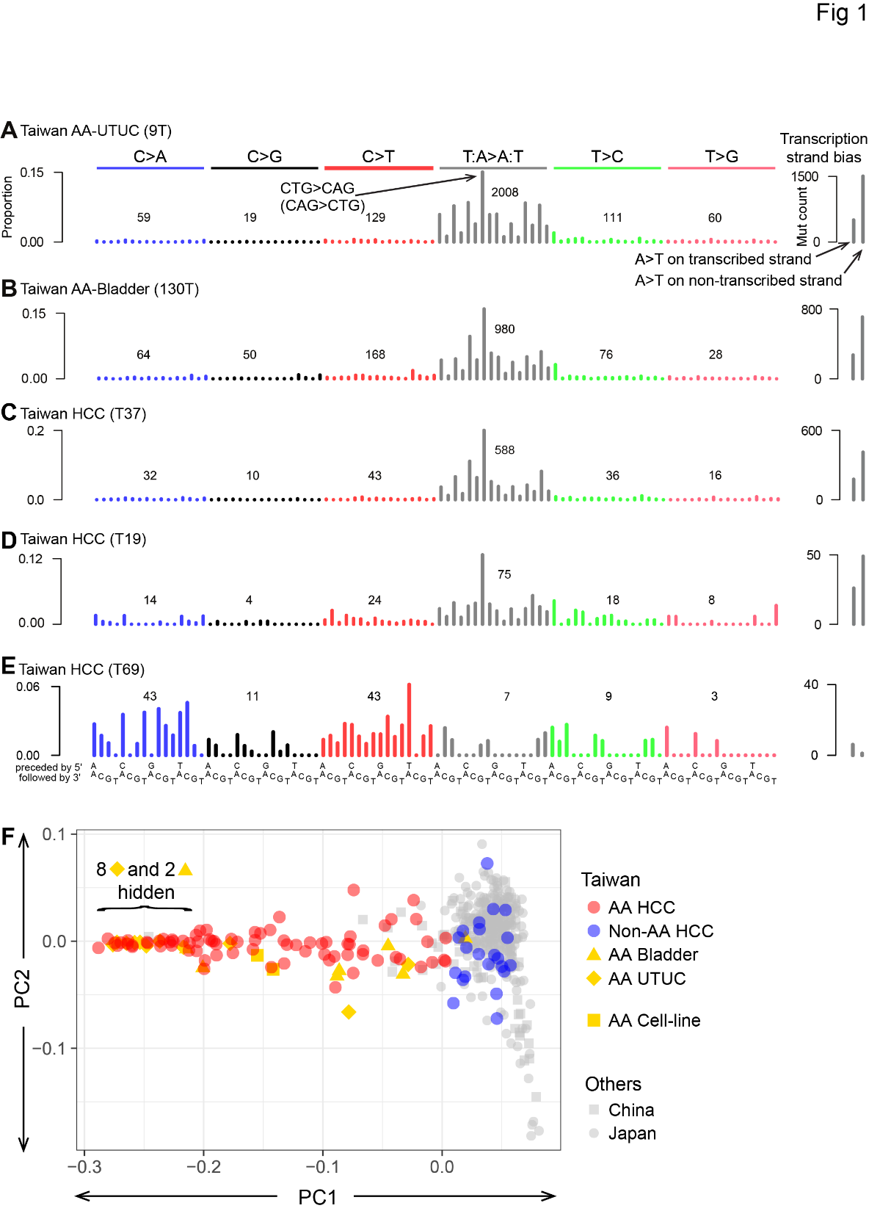
2017: 78% of Taiwan liver cancers (HCCs) had the AA signature
Red bars show numbers of mutations caused by AA
(exome data)
Ng, Poon, et al., Oct 2017 DOI: 10.1126/scitranslmed.aan6446

Slide 25
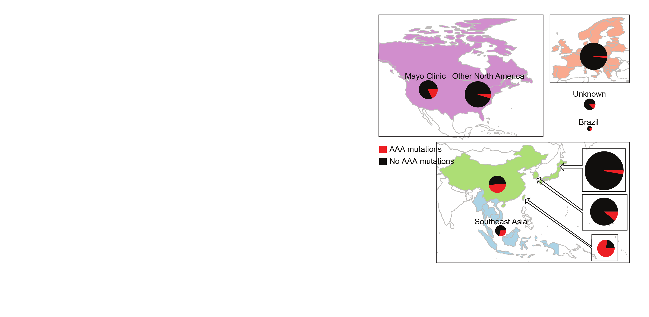
Today: 2,000 liver cancers – AA exposure is prevalent
AA mutations
No AA mutations
“Asian” patients with no “country” – Overseas patients?
Ng, Poon, et al., Oct 2017 DOI: 10.1126/stranslmed.aan6446 and subsequent publications; Zhang et al., 2017, Gastroenterology, 10.1053/j.gastro.2017.03.024; Gao et al., 2019, Cell, 10.1016/j.cell.2019.08.052; Xue et al., 2019, Cancer Cell, 10.1016/j.ccell.2019.04.007; Unpublished data, 2022

Slide 26
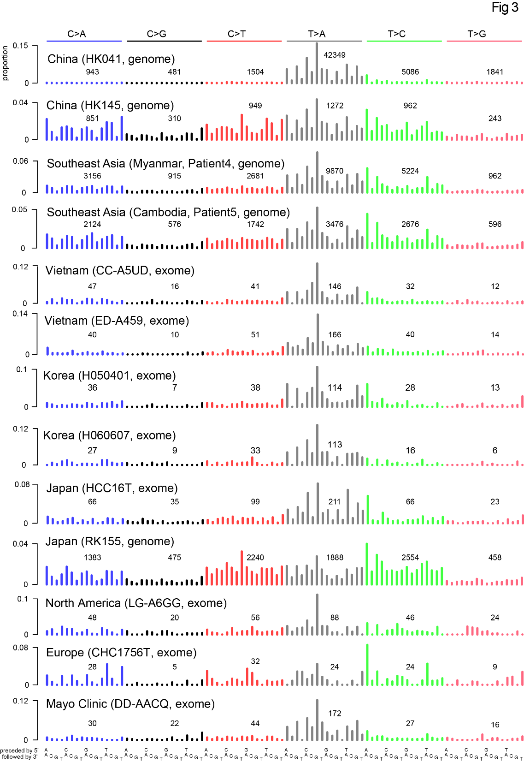

Slide 28
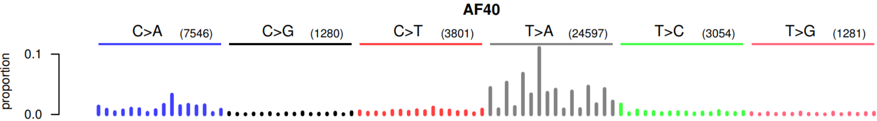
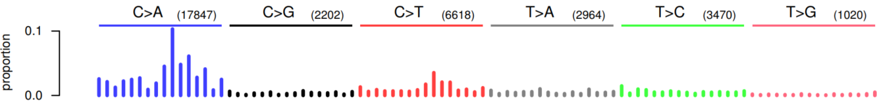
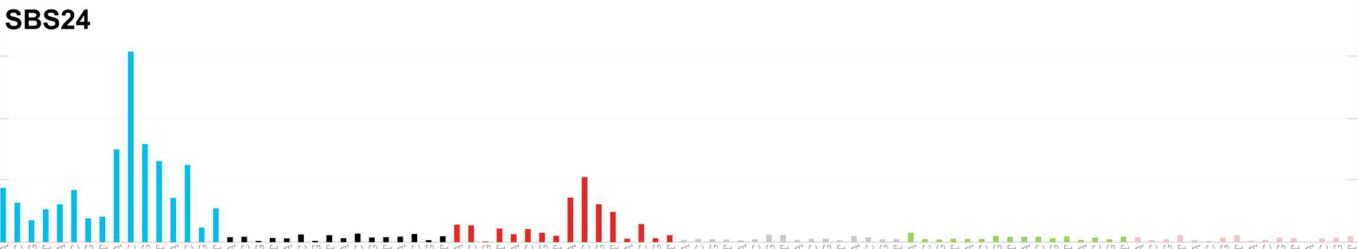
Aflatoxin is a well-established liver carcinogen AA mutation counts and aflatoxin mutation counts in HCC are similar
AA-associated mutation count
7546
3801
24597
Aflatoxin-associated mutation counts
17847
6618
Aflatoxin-associated mutational signature
Zhang et al., 2017, Gastroenterology, 10.1053/j.gastro.2017.03.024 Genetic Features of Aflatoxin-Associated Hepatocellular Carcinoma; tumors from Qidong (启东); 38% of maize (corn) samples have aflatoxin

Slide 29
Number of AA mutations was variable
AA signature mutations
in tumours with the signature
(mutations per megabase)
2.26 AA mutations / Mb
Taiwan
Mainland China
Other SE Asia
Vietnam
Korea
Japan
North America
Europe
Mayo Clinic
No information
0.29 AA mutations / Mb

Slide 30
Many AA-exposed liver cancers have multiple known cancer driver genes with AA mutations (as of 2017)
Taiwan
Mainland China
Other SE Asia
Vietnam
Korea
Japan
North America
Europe
Mayo Clinic
Unknown
Number of AA mutations
in known driver genes, per tumor
Geographical region

Slide 31
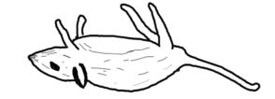
Strong evidence that AA can cause liver cancer
AA mutations
No AA mutations
Known mutagen and urinary tract carcinogen
Multiple known cancer driver genes with AA mutations
Linear relationship between AA dose and risk of liver cancer in hepatitis-B-infected and hepatitis-C-infected patients
AA causes liver cancer in mice
“Asian” patients with no “country” – Overseas patients?
Ng, Poon, et al., Oct 2017 DOI: 10.1126/stranslmed.aan6446 and subsequent publications; Zhang et al., 2017, Gastroenterology, 10.1053/j.gastro.2017.03.024; Gao et al., 2019, Cell, 10.1016/j.cell.2019.08.052Xue et al., 2019, Cancer Cell,10.1016/j.ccell.2019.04.007; Hsieh et al., 2008, 10.1186/1749-8546-3-13; Chen et al., 2018, International Journal of Cancer, 10.1002/ijc.31544; Chen et al., 2019,Cancer Epidemiology, Biomarkers & Prevention, 10.1158/1055-9965.EPI-19-0023; Lu et al. 2019 Hepatology 10.1002/hep.30863; Chen et al., 2022, Acta Pharmaceutica Sinica B 10.1016/j.apsb.2021.11.011

Slide 32
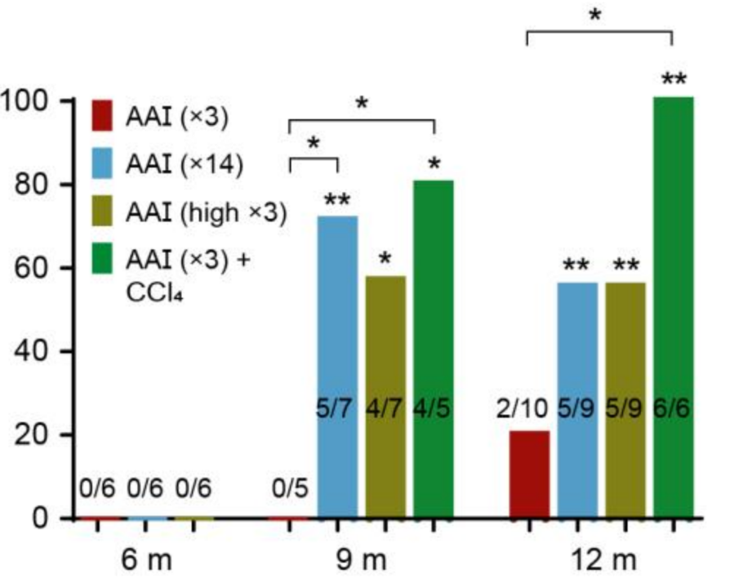
AA causes liver cancer in mice
The mutational features of aristolochic acid-induced mouse and human liver cancers
Zhao-Ning Lu, Qing Luo, Li-Nan Zhao,
Yi Shi, Na Wang, Lan Wang,
Ze-Guang Han
Hepatology, 2019, 10.1002/hep.30863
2.5 mg/kg X 3
2.5 mg/kg X 14
** or * = significant
versus untreated
5 mg/kg X 3
Tumor incidence (%)
Months after exposure
Notes:
3 X AAI = 7.5 14 X AAI = 35 high X 3= 15

Slide 33
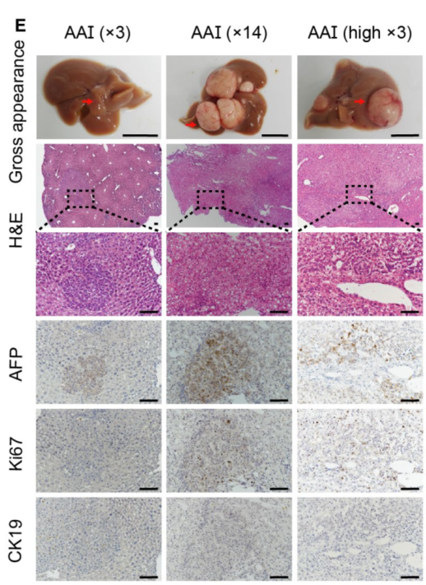
AA causes liver cancer in mice
2.5 mg/kg X 3
2.5 mg/kg X 14
5 mg/kg X 3
The mutational features of aristolochic acid-induced mouse and human liver cancers
Zhao-Ning Lu, Qing Luo, Li-Nan Zhao,
Yi Shi, Na Wang, Lan Wang,
Ze-Guang Han
Hepatology, 2019, 10.1002/hep.30863
Notes:
3 X AAI = 7.5 14 X AAI = 35 high X 3= 15

Slide 34
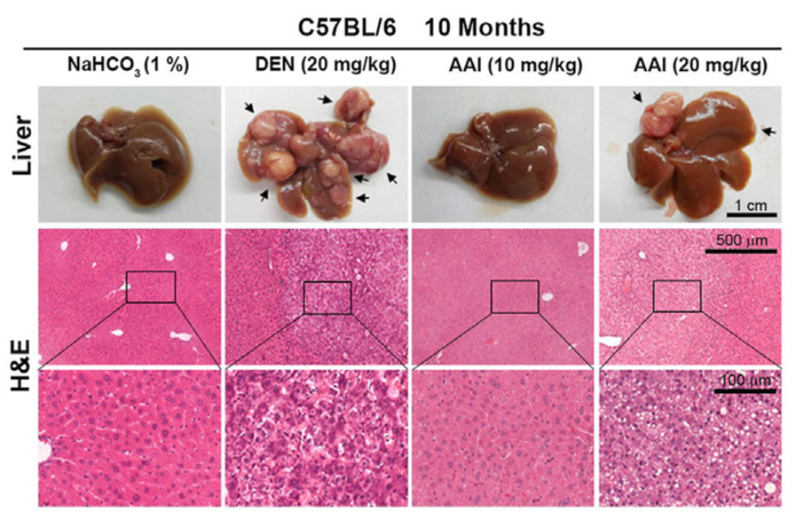
Single IP injection at 2 weeks
Chen et al., 2022, Acta Pharmaceutica Sinica B 10.1016/j.apsb.2021.11.011

Slide 35
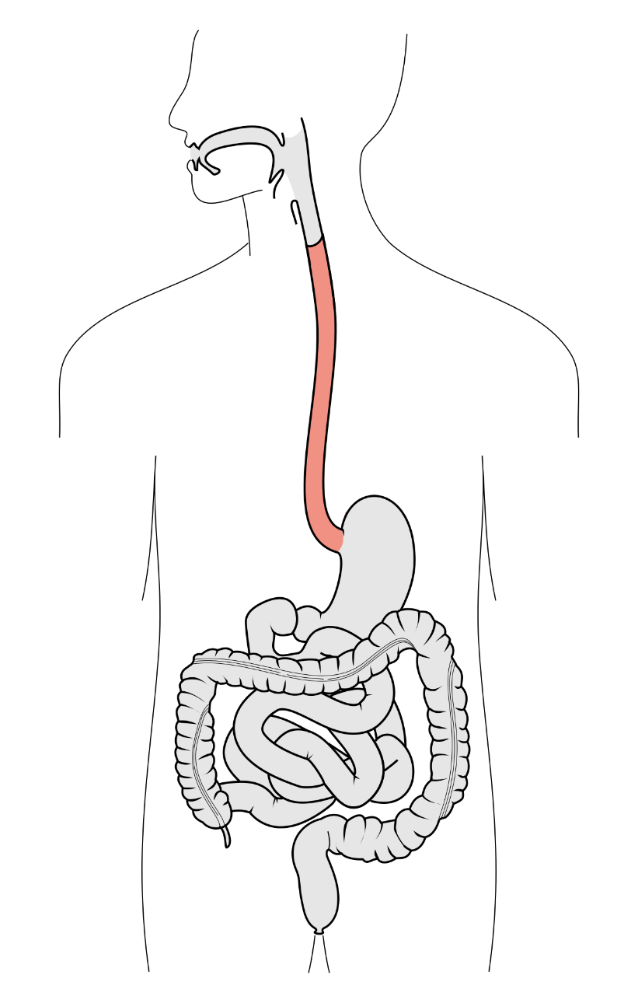
2021: Six cancer types with AA mutagenesis Strong evidence for causal roles in liver and urothelial cancers
Esophagus (squamous cell)
Liver
Bile duct
Kidney
Upper tract urothelial
Bladder
Notes:
Poon et al., 2013 and subsequent data (liver - hepatocellular carcinoma [HCC])
Zou et al., 2015, Jusakul et al., 2017 (bile duct carcinoma)
Scelo et al., 2014, Jelakovic et al., 2014 (kidney/renal cell carcinoma)
Poon et al., 2013, Hoang et al., 2013, many others (upper tract urothelial carcinoma)
Poon et al., 2015, others (bladder urothelial carcinoma)
Esophagus:
Yan et al, 2019, Nat Commun, doi: 10.1038/s41467-019-09255-1
Cui et al., 2020, Cell Research, doi: 10.1038/s41422-020-0333-6

Slide 36
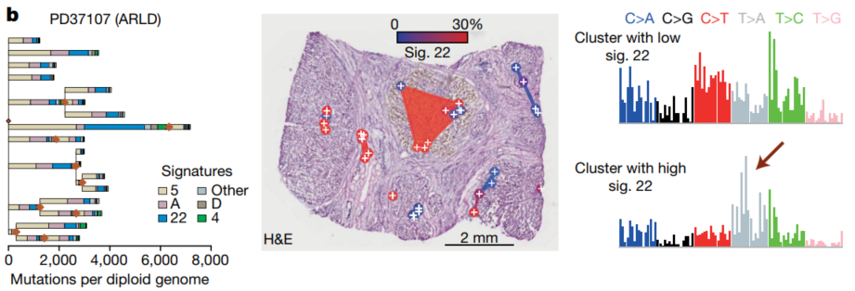
Non cancer liver damage
Brunner 2019, Nature, 10.1038/s41586-019-1670-9; focuses on multiregional mutational landscape of healthy and cirrhotic human liver; stumbled upon 1 AA-exposed liver with alcohol-related liver disease
Ongoing exposure during tumor grown
Extremely variable mutation levels across regions

Slide 37
Non cancer liver damage, continued
Jin 2017, dog liver, Cancer Prevention Research, 10.1158/1940-6207.CAPR-15-0339
Li 2016, human liver organoid, Oncotarget, 7:48
High Lin28B, c-Myc, alpha-fetoprotein
Xu 2021, chicken, animals (journal), 10.3390/ani11123437
Wang 2021, rat, Toxicology Mechanisms and Methods, 10.1080/15376516.2021.1946229
oxidative stress and mitochondrial apoptosis

Slide 38
But it’s not a problem, because AA is “banned”
The word “banned” is hopelessly vague
For example
In the US, the Dietary Supplement Health and Education Act of 1994 lets companies sell any herbs marketed before 1994
Food and Drug Administration has no funds to test the safety of “grandfathered” herbs

Slide 39
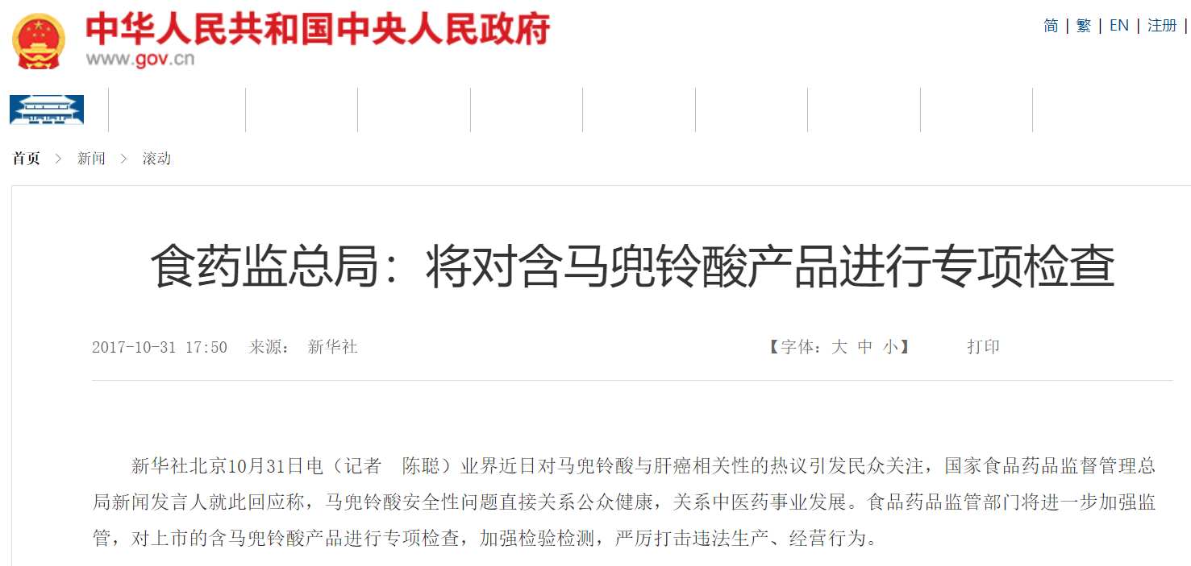
October 2017: Rreassuring statements
The food and drug inspection head office will carry out a focused examination of aristolochic-acid-containing products

Slide 40
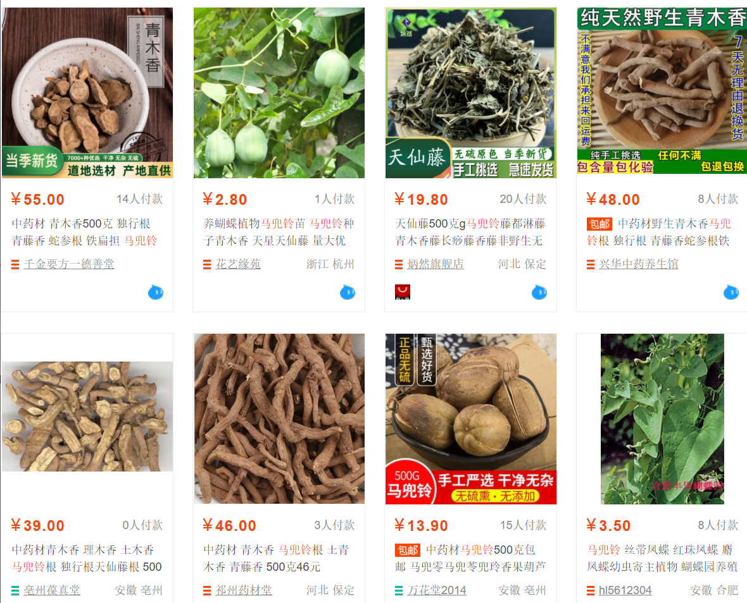
July 2021: Easy to buy
Top results of a search for ma dou ling (马兜铃, Aristolochia contorta or A. debilis) on a popular shopping website on 9 July 2021.
Dried roots (青木香)
Dried above-ground parts (天仙藤)
Dried seed pods (马兜铃, lower left)

Slide 41
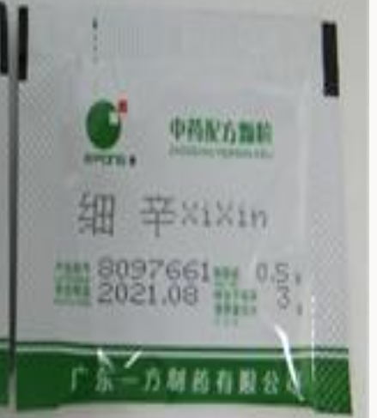
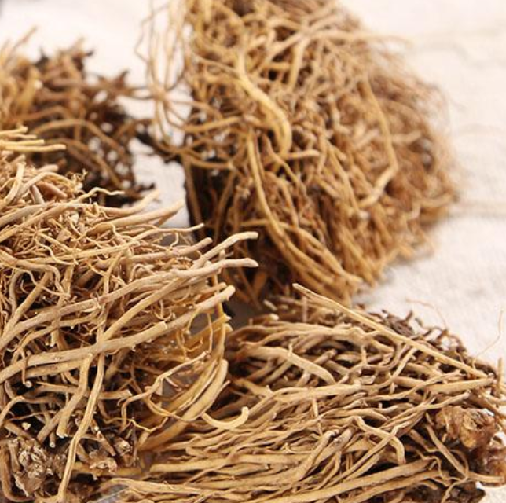
Singapore
Powdered wild ginger root (xi xin, 细辛) in a packet
Tested and recalled by the Singapore Health Sciences Authority because it contained AA
Wild ginger root (xi xin,细辛) as a raw herb
Not tested by the Health Sciences Authority

Slide 42
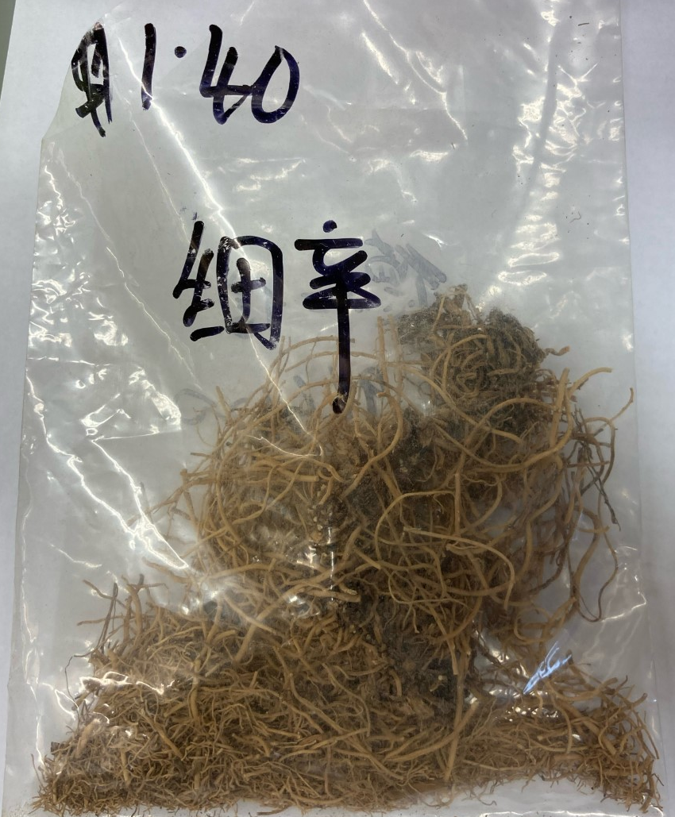
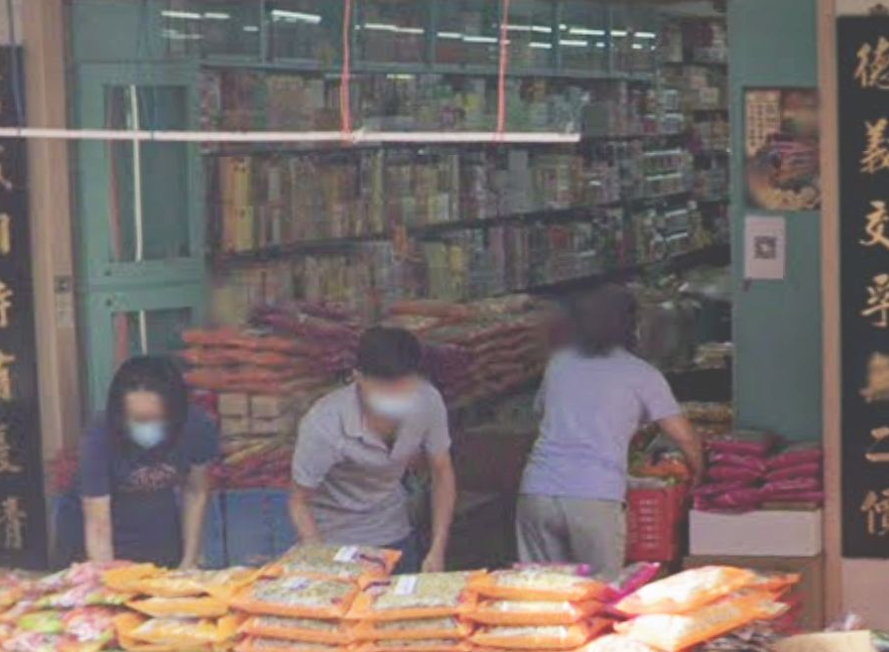
AA in wild ginger (xi xin, 细辛) roots bought in Singapore
Ho Szu-Chi

Slide 43
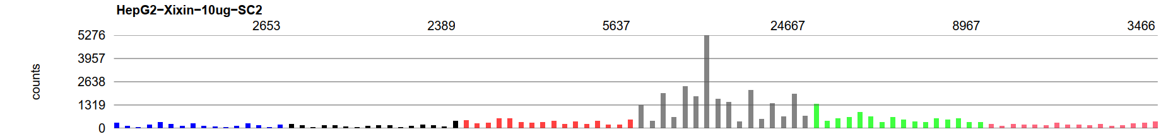
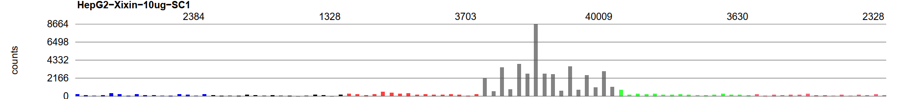
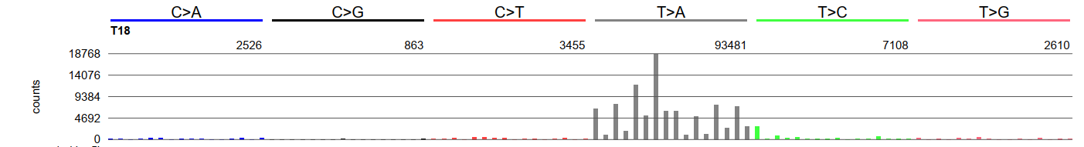
Strong AA mutagenesis from wild ginger bought in Singapore
Wild-ginger-exposed cells (replicate 1)
Wild-ginger-exposed cells (replicate 2)
AA exposed urothelial cancer
Ho Szu-Chi

Slide 44
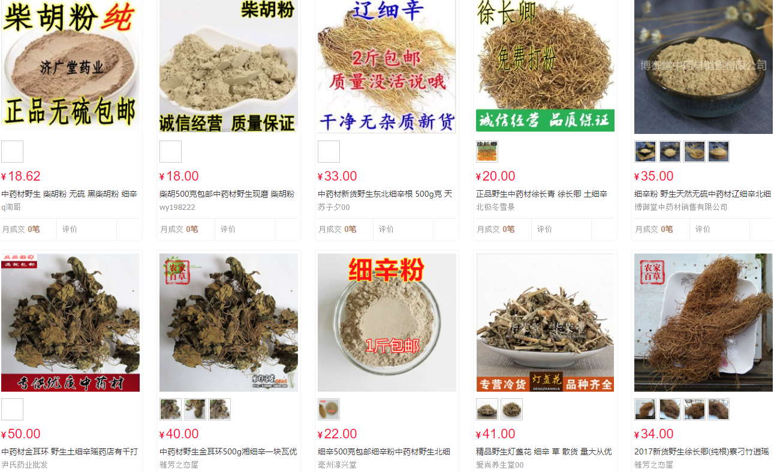
Wild ginger (xi xin, 细辛) products

Slide 45
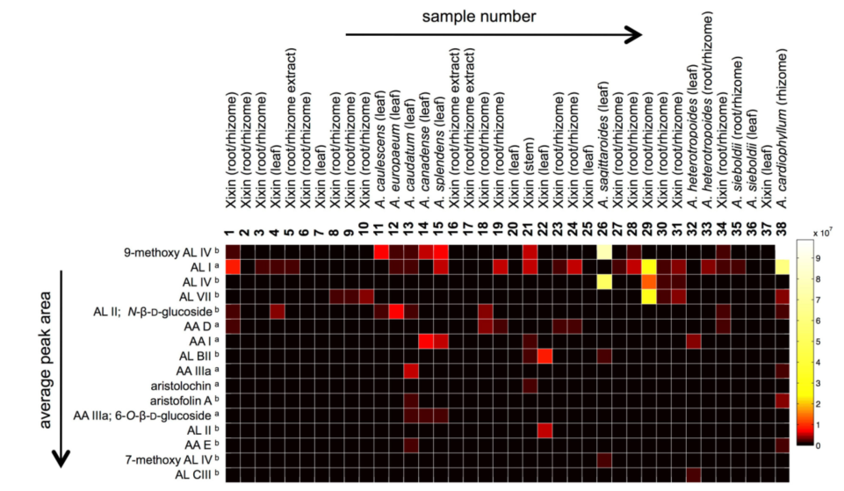
Hard to regulate because of variable phytochemistry and difficult identification
Analytical chemistry of wild ginger (xi xin, 细辛) samples
Note: mostly no species identification
Johanna Michl, …, Michael Heirich, 2017, 10.3389/fphar.2017.00215

Slide 46


Variable and diverse AA content
Each column is a sample
关木通 guān mù tōng (stem of
Aristolochia manshuriensis)
High concentration
Each row is a different AA analog
Low concentration
Michl et al., 2015, J. Natural Products doi:10.1021/acs.jnatprod.5b00556
Notes:
https://www.e138.net/zhongyao/cai-141.html

Slide 47
AA – more questions than answers
What is the dose-risk relationship between AA exposure and liver cancer? Is there interaction with hepatitis?
How are people being exposed? Which herbs? How prepared?
What is the extent of exposure in Africa and Latin America?
What are effective approaches to education and regulation?
Can non-invasive tests (e.g. blood tests) for AA exposure be developed for clinical or research use?
A non-invasive test would enable secondary prevention: exposed individuals might benefit from screening
Can I convince funders that prevention is worthy of funding even it will not help anyone who already has cancer?

Slide 48
Acknowledgements - Funding
Singapore National Medical Research Council
Singapore Ministry of Health via the Duke-NUS Signature Research Programmes
Chang Gung Medical Foundation

Slide 49

Acknowledgements
Singapore (Duke NUS,
National Cancer Centre
Singapore, and Johns Hopkins Singapore,
TOP2 and AA)
Alvin NG Wei Tian (黄伟添)
Arnoud Boot
Mo LIU (刘陌)
Nanhai JIANG (蒋南海)
Shenli Zhang
Szu-Chi Ho
Willie Yu
Cedric C. Y. Ng
Patrick Tan
Bin Tean TEH
Alex Chang
(UTUC, HCC)
Sen-Yung Hsieh (谢森永)
Hao-Yi Huang
Ming-Chin Yu
Po-Hung Lin (林柏宏)
Jacob See-Tong PANG

Slide 50

Questions?
Slides at https://github.com/steverozen/AA-liver
Shen nong (神农) died after eating a poisonous herb

Slide 51
Backup slides

Slide 52

M. Heinrich et al 2009
doi:10.1016/j.jep.2009.05.028

Slide 53
Table S6. Drivers identified by MutSigCV or 20/20+ in 98 Taiwan HCCs.
Gene | Proportion of Taiwan HCCs with mutation | Classification in Cancer Gene Census | Notes | Proportion with mutations in TCGA 2017
TP53 | 0.54 | TSG | Commonly mutated in HCC | 0.31
CTNNB1 | 0.24 | oncogene | Commonly mutated in HCC | 0.27
ALB | 0.21 |  | Commonly mutated in HCC, status as driver controversial | 0.13
AXIN1 | 0.17 | TSG | Commonly mutated in HCC | 0.08
DOCK8 | 0.11 |  | Not expressed in liver or liver cancer (http://www.proteinatlas.org/ENSG00000107099-DOCK8/cancer); not observed in any other HCC genomic study | NR
BRD7 | 0.09 |  | Observed in Totoki et al., 2014 , Fujimoto et al., 2016 | NR
ARID2 | 0.09 | TSG | Observed in multiple other HCC genomic studies | 0.05
RPS6KA3 | 0.08 |  | Observed in multiple other HCC genomic studies | 0.04
IRF2 | 0.06 |  | Reported as an HCC TSG in Guichard et al., 2012 | NR
RAG1 | 0.06 |  | Activation of immunoglobulin V-D-J recombination.; not likely to have a role in hepatocytes or liver cancer | NR
RB1 | 0.06 | TSG | Observed in multiple other HCC genomic studies | 0.04
PBRM1 | 0.05 | TSG | Observed in multiple other HCC genomic studies | NR

Slide 54

Variable and diverse AA content
Each column is a sample
天仙藤 tiān xiān téng (thin stems and leaves of Aristolochia debilis)
High concentration
Each row is a different AA analog
Low concentration
Michl et al., 2015, J. Natural Products doi:10.1021/acs.jnatprod.5b00556

